Slide 1

Visión por Computador
Domingo Mery
Departmento de Ciencia de la Computación
Escuela de Ingeniería
Universidad Católica de Chile
Deep Learning

Slide 2
Motivation

Slide 3
Images of different
known classes
Representation
Class 1
Feature Feature Design of
Extraction Selection Classifier
Class 2
Class n
Stage 1: TRAINING
Stage 2: TESTING
Extraction of
selected
features
InputA: Test Image
Class
Classification
Output:

Slide 4
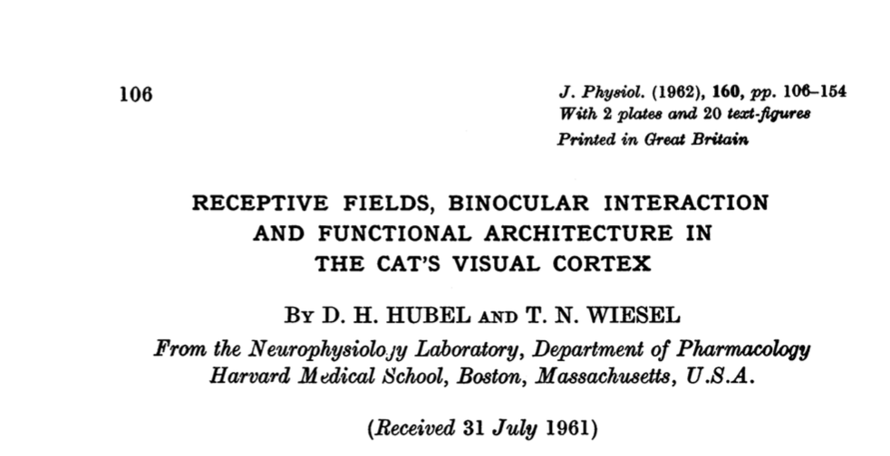
MOTIVATION
Cat experiments in the 60’s: Hubel & Wiesel
[ Video 1 ] [ Video 2 ] [ Paper ]

Slide 5
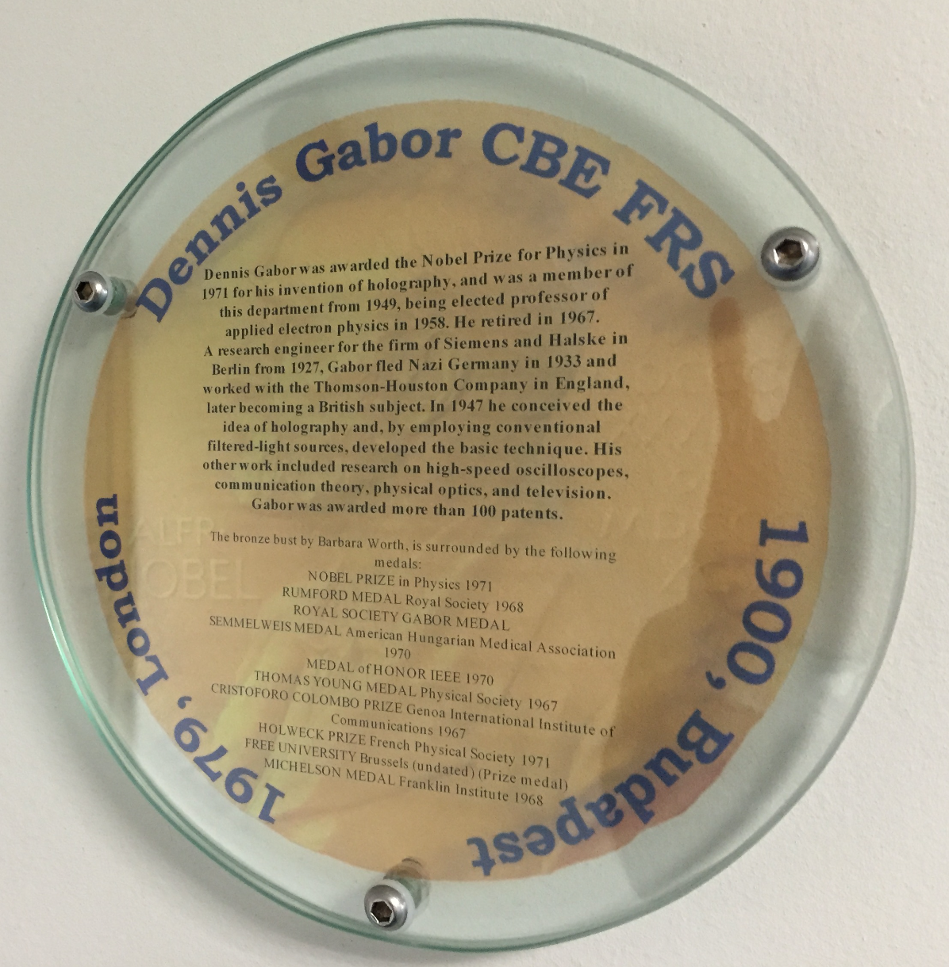
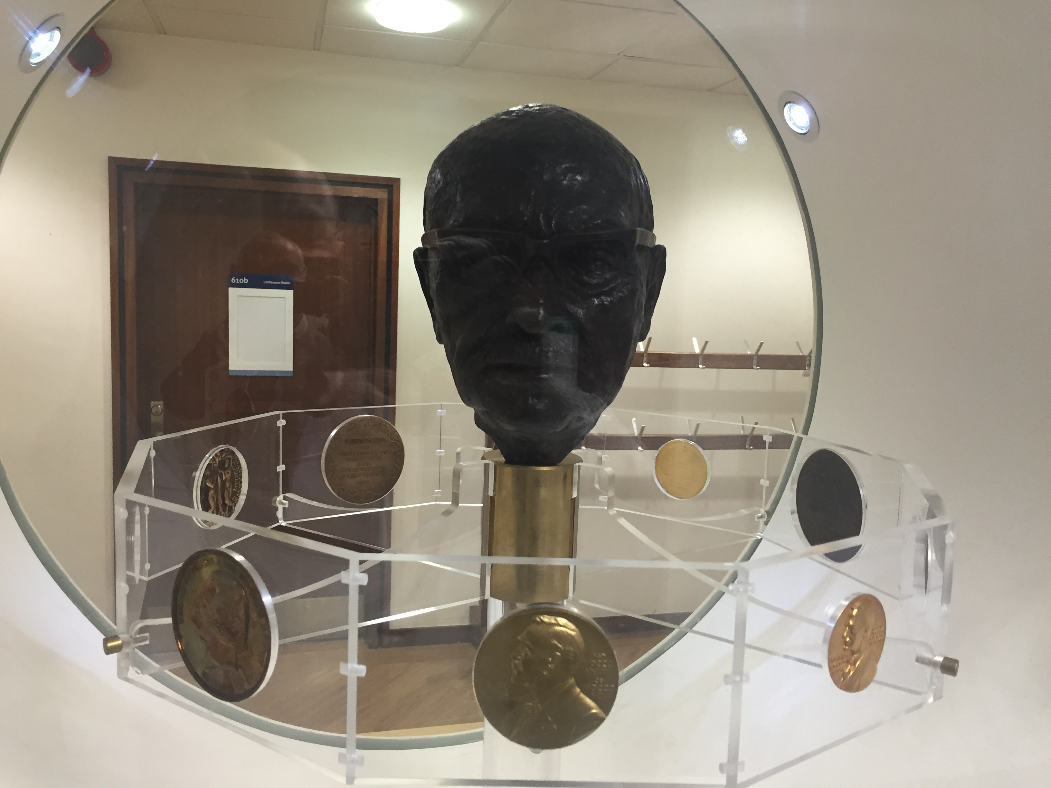
MOTIVATION
Gabor

Slide 6
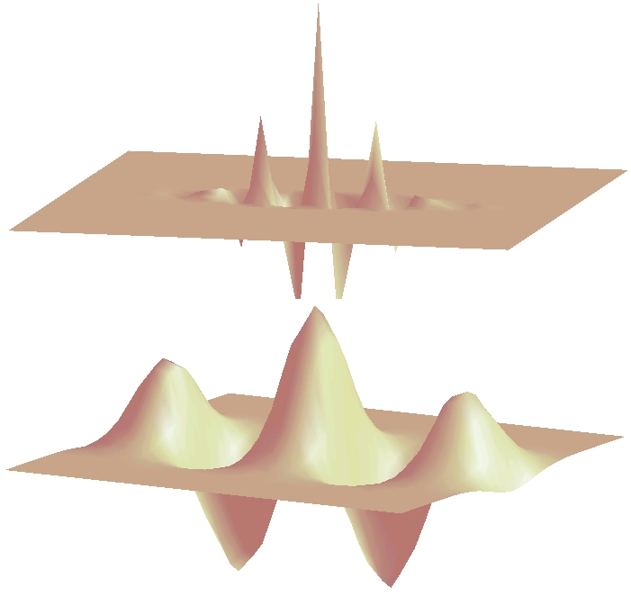
MOTIVATION
Gabor

Slide 7
MOTIVATION
Handcrafted vs. Learned features
LBP, Haralick, Fourier, Gabor, etc.
or
Learned representation from training data

Slide 8
MOTIVATION
Neural networks
x₁
x₂
y
:
:
x_{n}

Slide 9
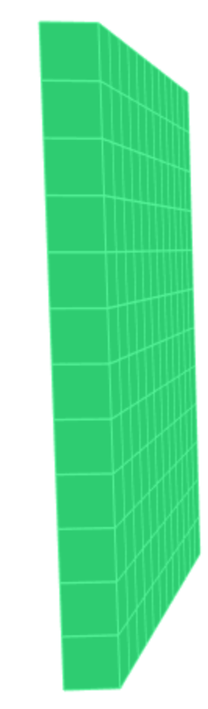
MOTIVATION
The idea is to classify an image X as y
Process
X
y

Slide 10

MOTIVATION
What happens if each pixel is an input?
y
How many neurons and weights?

Slide 11
Basics

Slide 12
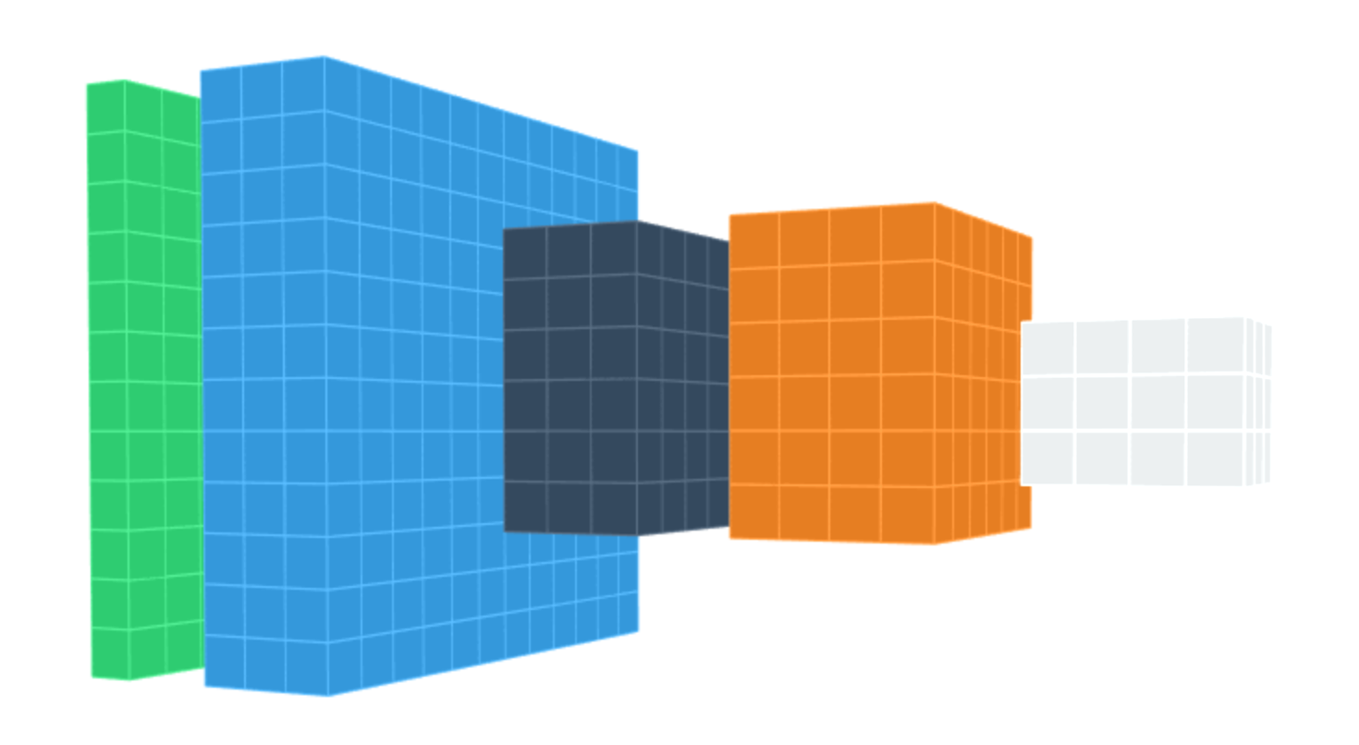
DEEP LEARNING BASICS
Data
representation
Input
image
Layers

Slide 13
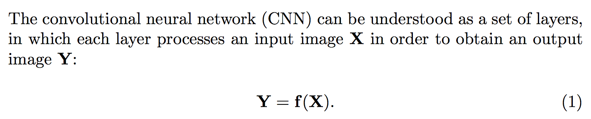
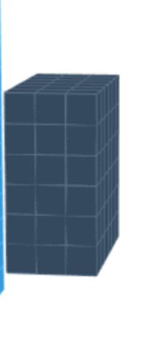
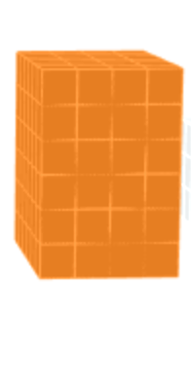
DEEP LEARNING BASICS
f
X
Y
parameters (to be learned)

Slide 14
DEEP LEARNING BASICS
Each layer:
f
X
Y

Slide 15
DEEP LEARNING BASICS
f₁
f₂
f₃
f₄
Data
representation
Input
image
Layers

Slide 16
DEEP LEARNING: Typical layers
Convolution layer
Pooling layer
Rectified Linear Unit
Downsampling
Fully connected and SoftMax

Slide 17
DEEP LEARNING: Typical layers
Convolution layer
Pooling layer
Rectified Linear Unit
Downsampling
Fully connected and SoftMax

Slide 18
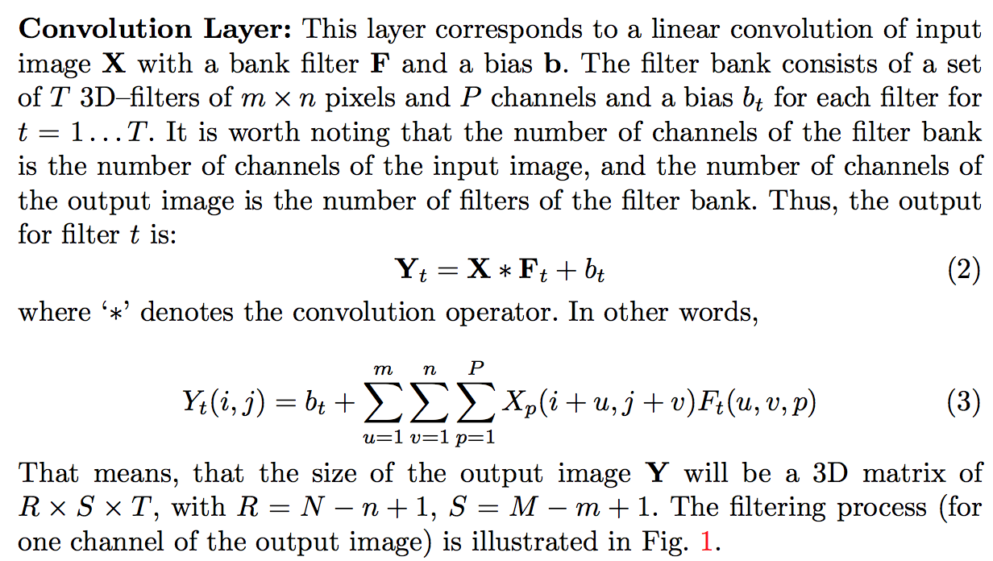
DEEP LEARNING: Convolution layer

Slide 19
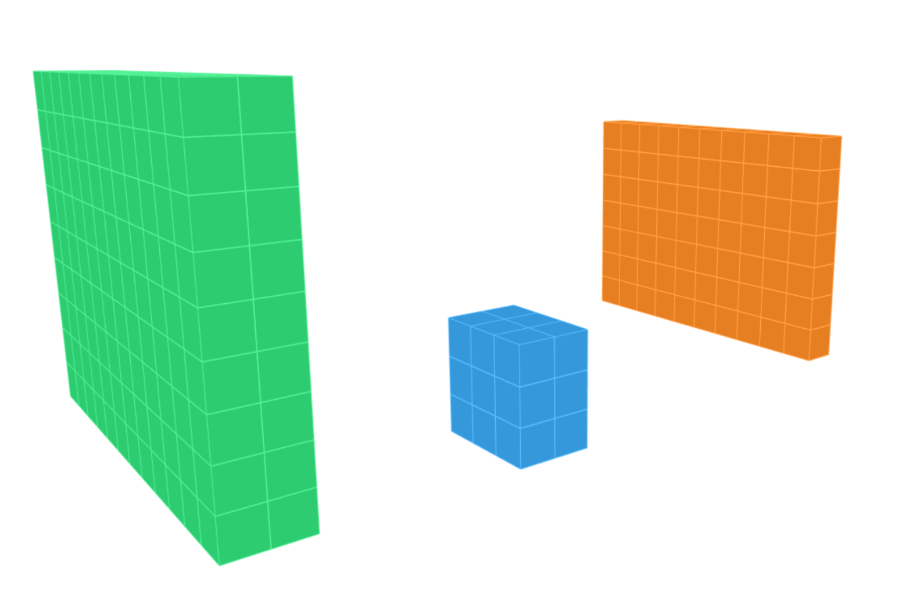
DEEP LEARNING: Convolution layer
X
N-n+1
M
M-m+1
m
N
n
for
P

Slide 20
DEEP LEARNING: Typical layers
Convolution layer
Pooling layer
Rectified Linear Unit
Downsampling
Fully connected and SoftMax

Slide 21
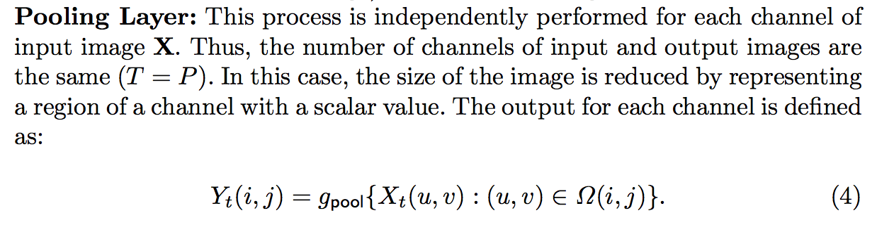
DEEP LEARNING: Pooling layer

Slide 22
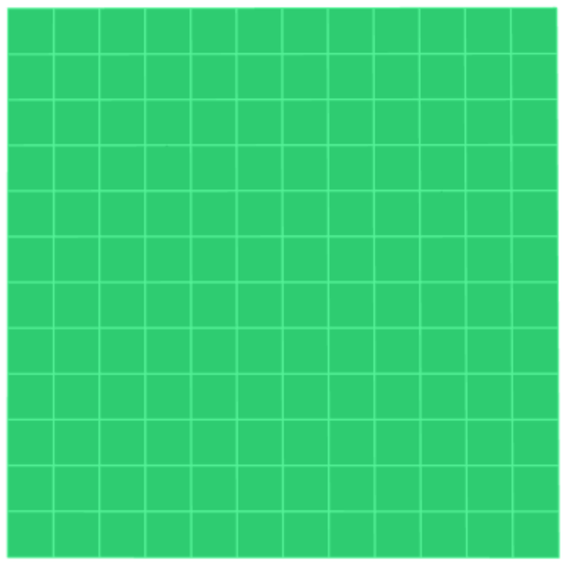
DEEP LEARNING: Pooling layer
max

Slide 23
DEEP LEARNING: Pooling layer
max

Slide 24
DEEP LEARNING: Pooling layer
max

Slide 25
DEEP LEARNING: Pooling layer
max

Slide 26

DEEP LEARNING: Pooling layer
max

Slide 27
DEEP LEARNING: Typical layers
Convolution layer
Pooling layer
Rectified Linear Unit
Downsampling
Fully connected and SoftMax

Slide 28
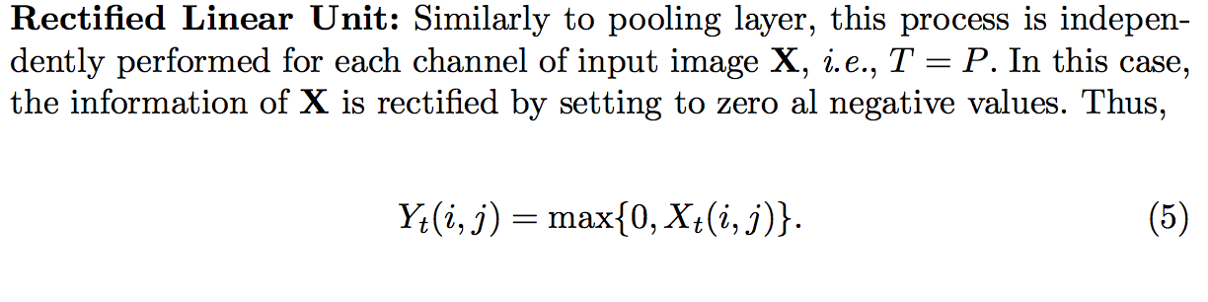
DEEP LEARNING: Rectified Linear Unit (ReLU)

Slide 29
DEEP LEARNING: Rectified Linear Unit (ReLU)

Slide 30
DEEP LEARNING: Typical layers
Convolution layer
Pooling layer
Rectified Linear Unit
Downsampling
Fully connected and SoftMax

Slide 31
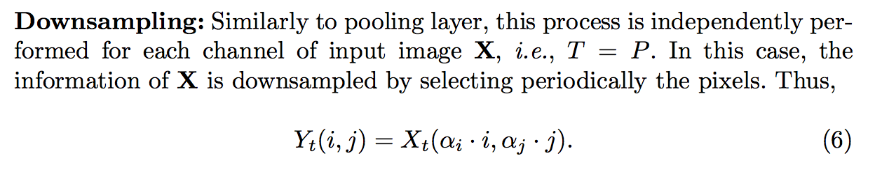
DEEP LEARNING: Downsampling

Slide 32
DEEP LEARNING: Downsampling

Slide 33
DEEP LEARNING: Typical layers
Convolution layer
Pooling layer
Rectified Linear Unit
Downsampling
Fully connected and SoftMax

Slide 34
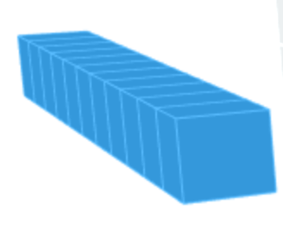
DEEP LEARNING: Fully Connected
one to one

Slide 35
DEEP LEARNING: SoftMax

Slide 36
Training

Slide 37
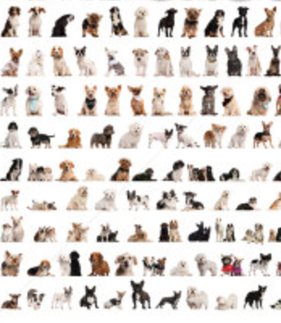
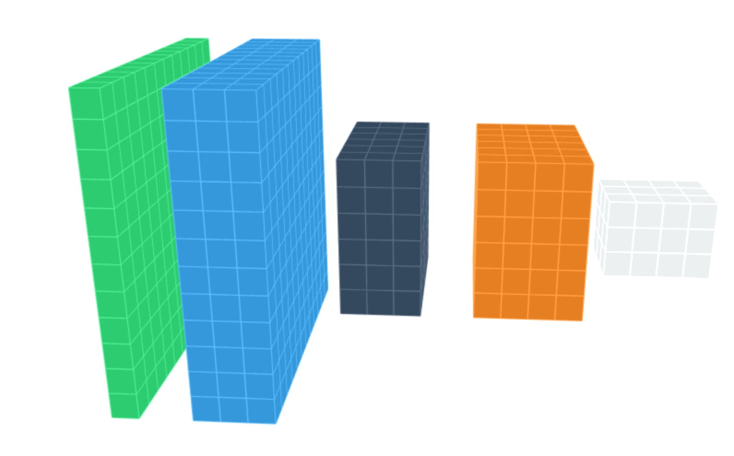


DEEP LEARNING: Training
dogs
errors
cats
Back-propagation

Slide 38
Example

Slide 39
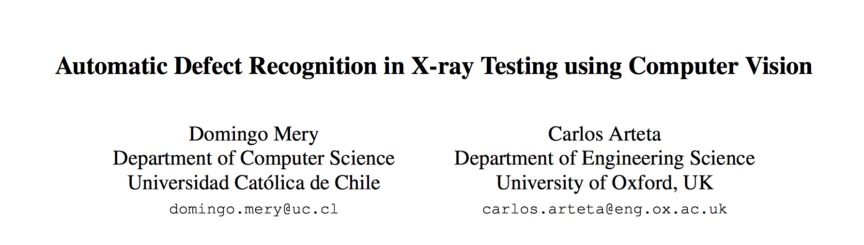
Mery, D.; and Arteta, C. Automatic Defect Recognition in X-ray Testing using Computer Vision. In 2017 IEEE Winter Conference on Applications of Computer Vision (WACV2017), 2017. [ PDF ]
PPT > PAT04_CNN_Example_WACV.pptx

Slide 40
State of the Art

Slide 41
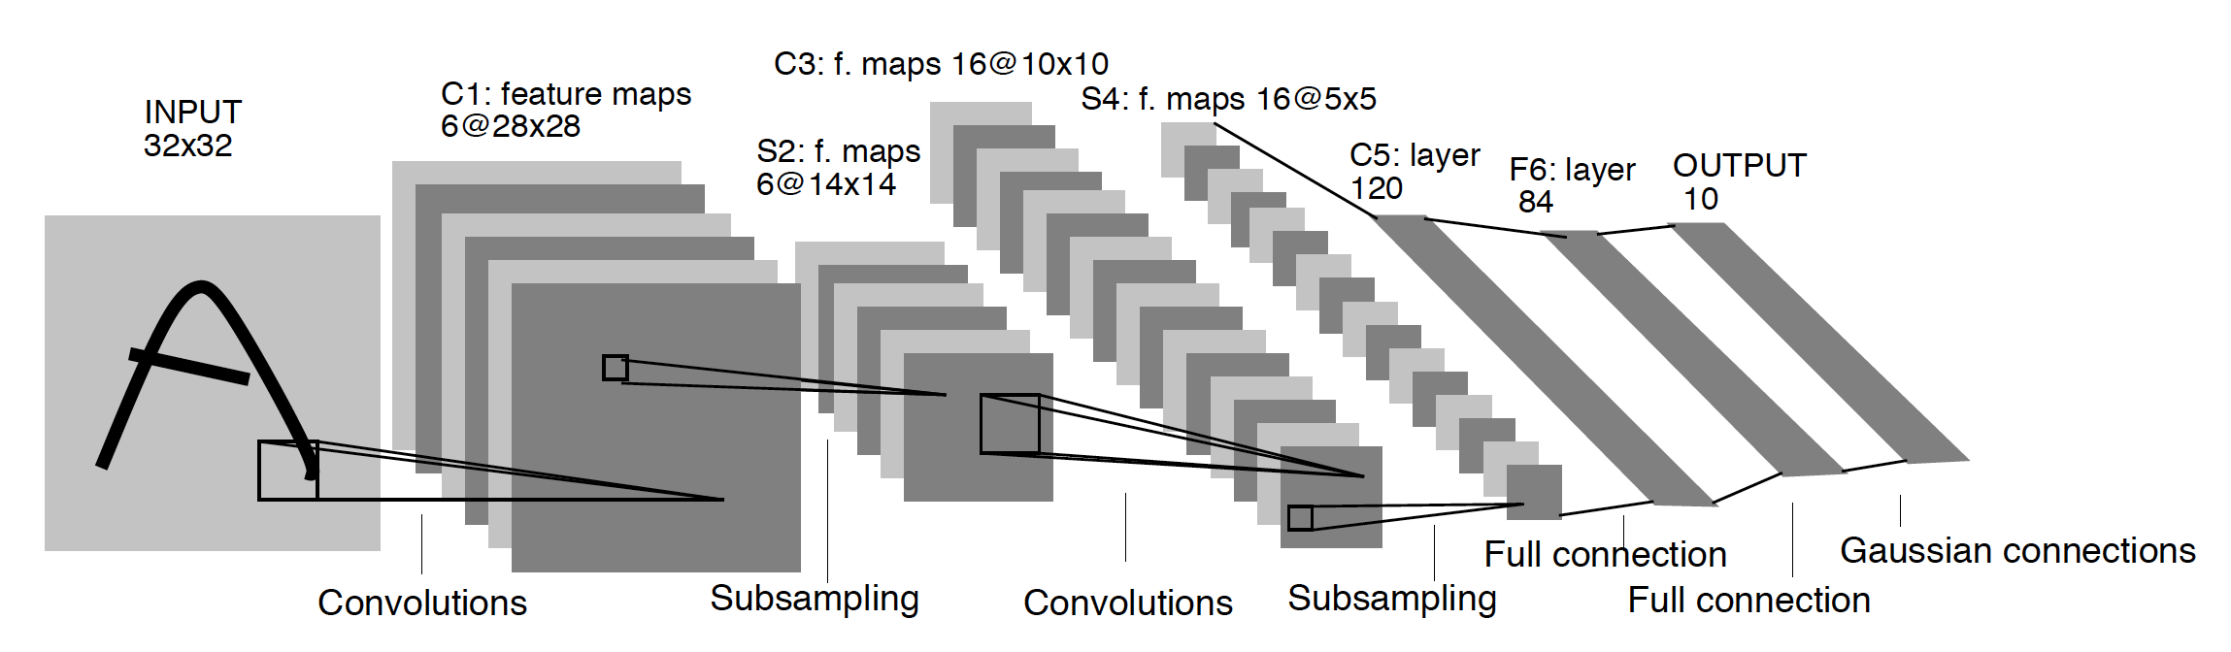
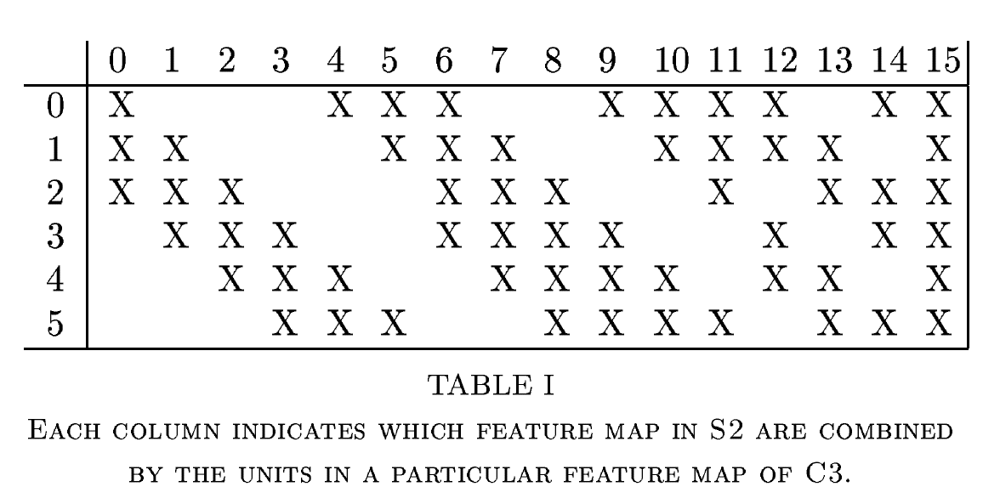
Digits recognition [ LeNet]
Y. LeCun, L. Bottou, Y. Bengio, and P. Haffner, “Gradient-based learning applied to document recognition,” Proceedings of the IEEE, vol. 86, no. 11, pp. 2278–2324, Nov. 1998. [ PDF ]

Slide 42
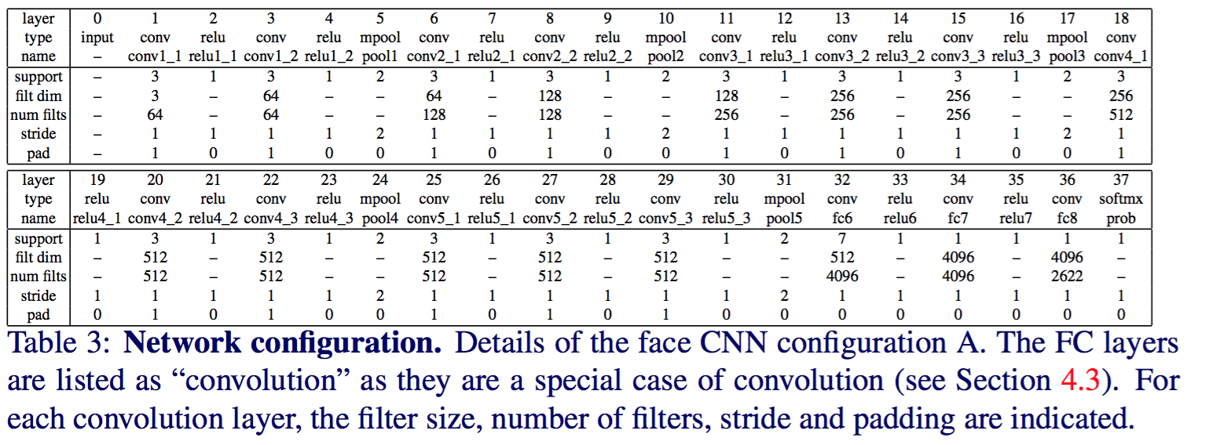
Face Recognition
O. M. Parkhi, A. Vedaldi, and A. Zisserman, “Deep face recognition,” presented at the Proceedings of the British Machine Vision Conference, 2015. [ PDF ]

Slide 43
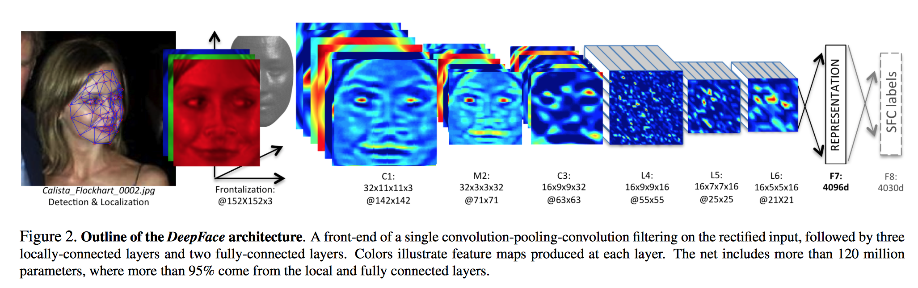
Face Recognition [ DeepFace ]
Taigman, Yaniv, et al. "Deepface: Closing the gap to human-level performance in face verification." Proceedings of the IEEE Conference on Computer Vision and Pattern Recognition. 2014. [ PDF ]

Slide 44
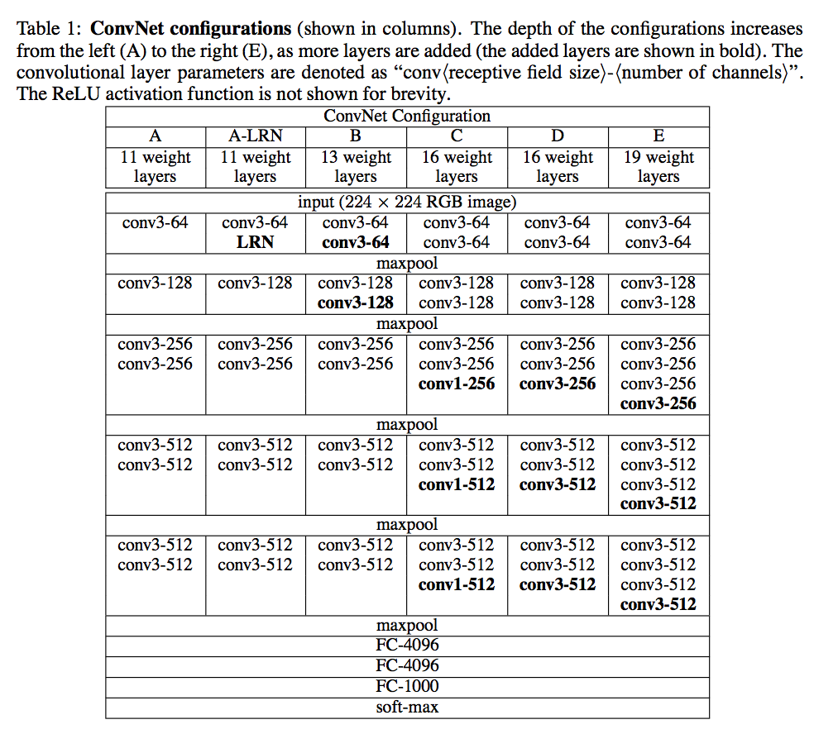
Object recognition
K. Simonyan and A. Zisserman, “Very Deep Convolutional Networks for Large-Scale Image Recognition.,” CoRR abs/1409.1556, 2014. [ PDF ]

Slide 45
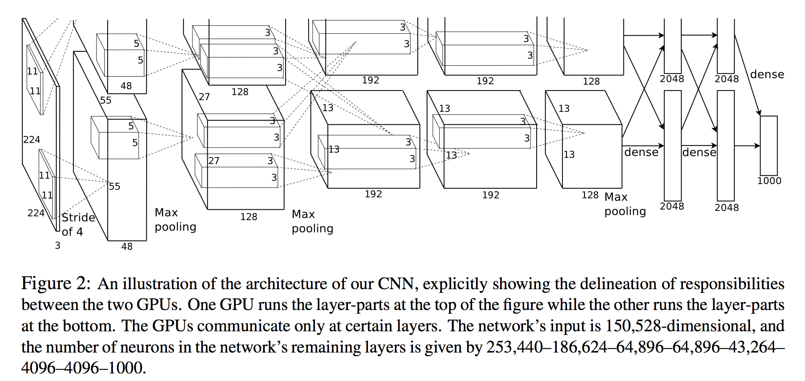
Object recognition [ AlexNet ]
A. Krizhevsky, I. Sutskever, and G. E. Hinton, “ImageNet Classification with Deep Convolutional Neural Networks.,” NIPS, pp. 1106–1114, 2012. [ PDF ]

Slide 46
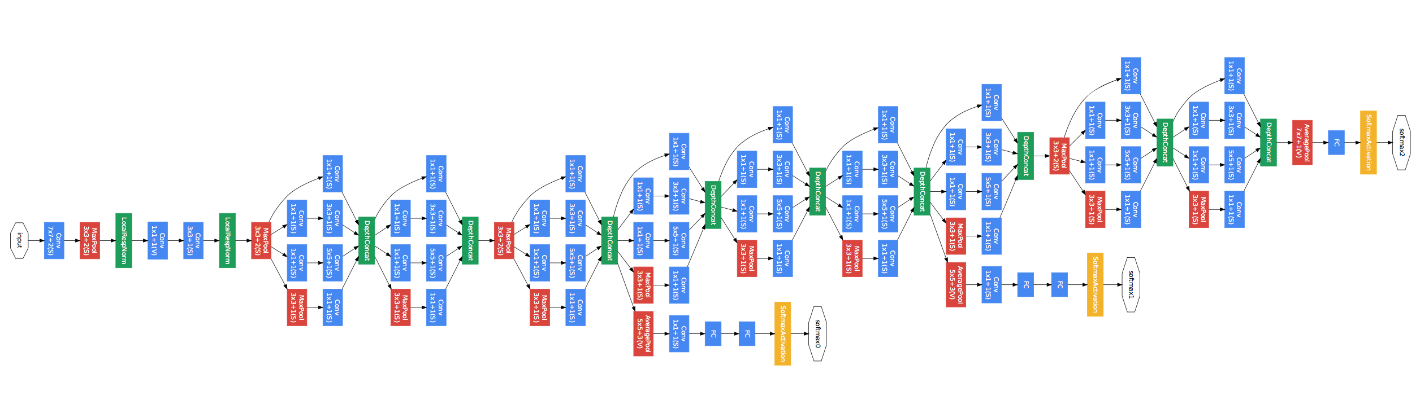
Object recognition [ GoogLeNet ]
Szegedy, Christian, Wei Liu, Yangqing Jia, Pierre Sermanet, Scott Reed, Dragomir Anguelov, Dumitru Erhan, Vincent Vanhoucke, and Andrew Rabinovich. "Going deeper with convolutions." In Proceedings of the IEEE Conference on Computer Vision and Pattern Recognition, pp. 1-9. 2015. [ PDF ]

Slide 47
References
See papers, books, courses, etc.
http://jiwonkim.org/awesome-deep-vision/
Neural networks and deep learning (book)
http://deeplearning.net/

Slide 48
Software

Slide 49
Software for Deep Learning
http://deeplearning.net/software_links/
MatConvNet > Examples
TensorFlow
Keras
etc.

